Slide 1

MEDIA & THE PUBLIC
Week 5 Information flow
Ryan Wang
ryanyang@psu.edu

Slide 2
Strong/Powerful media effect
McQuail’s four phrases model (2005)
WWI - 1930s
1930s – 1960s
Selective exposure
Magic Bullet
Hypodermic Needle
Two-step flow
Agenda setting
1970s -
Social constructivism
1960s – 1970s
Spiral of silence
Cultivation
Framing
Limited media effect
Revisit of strong media effect
Negotiated/transactional media effect
One step
Two steps

Slide 3

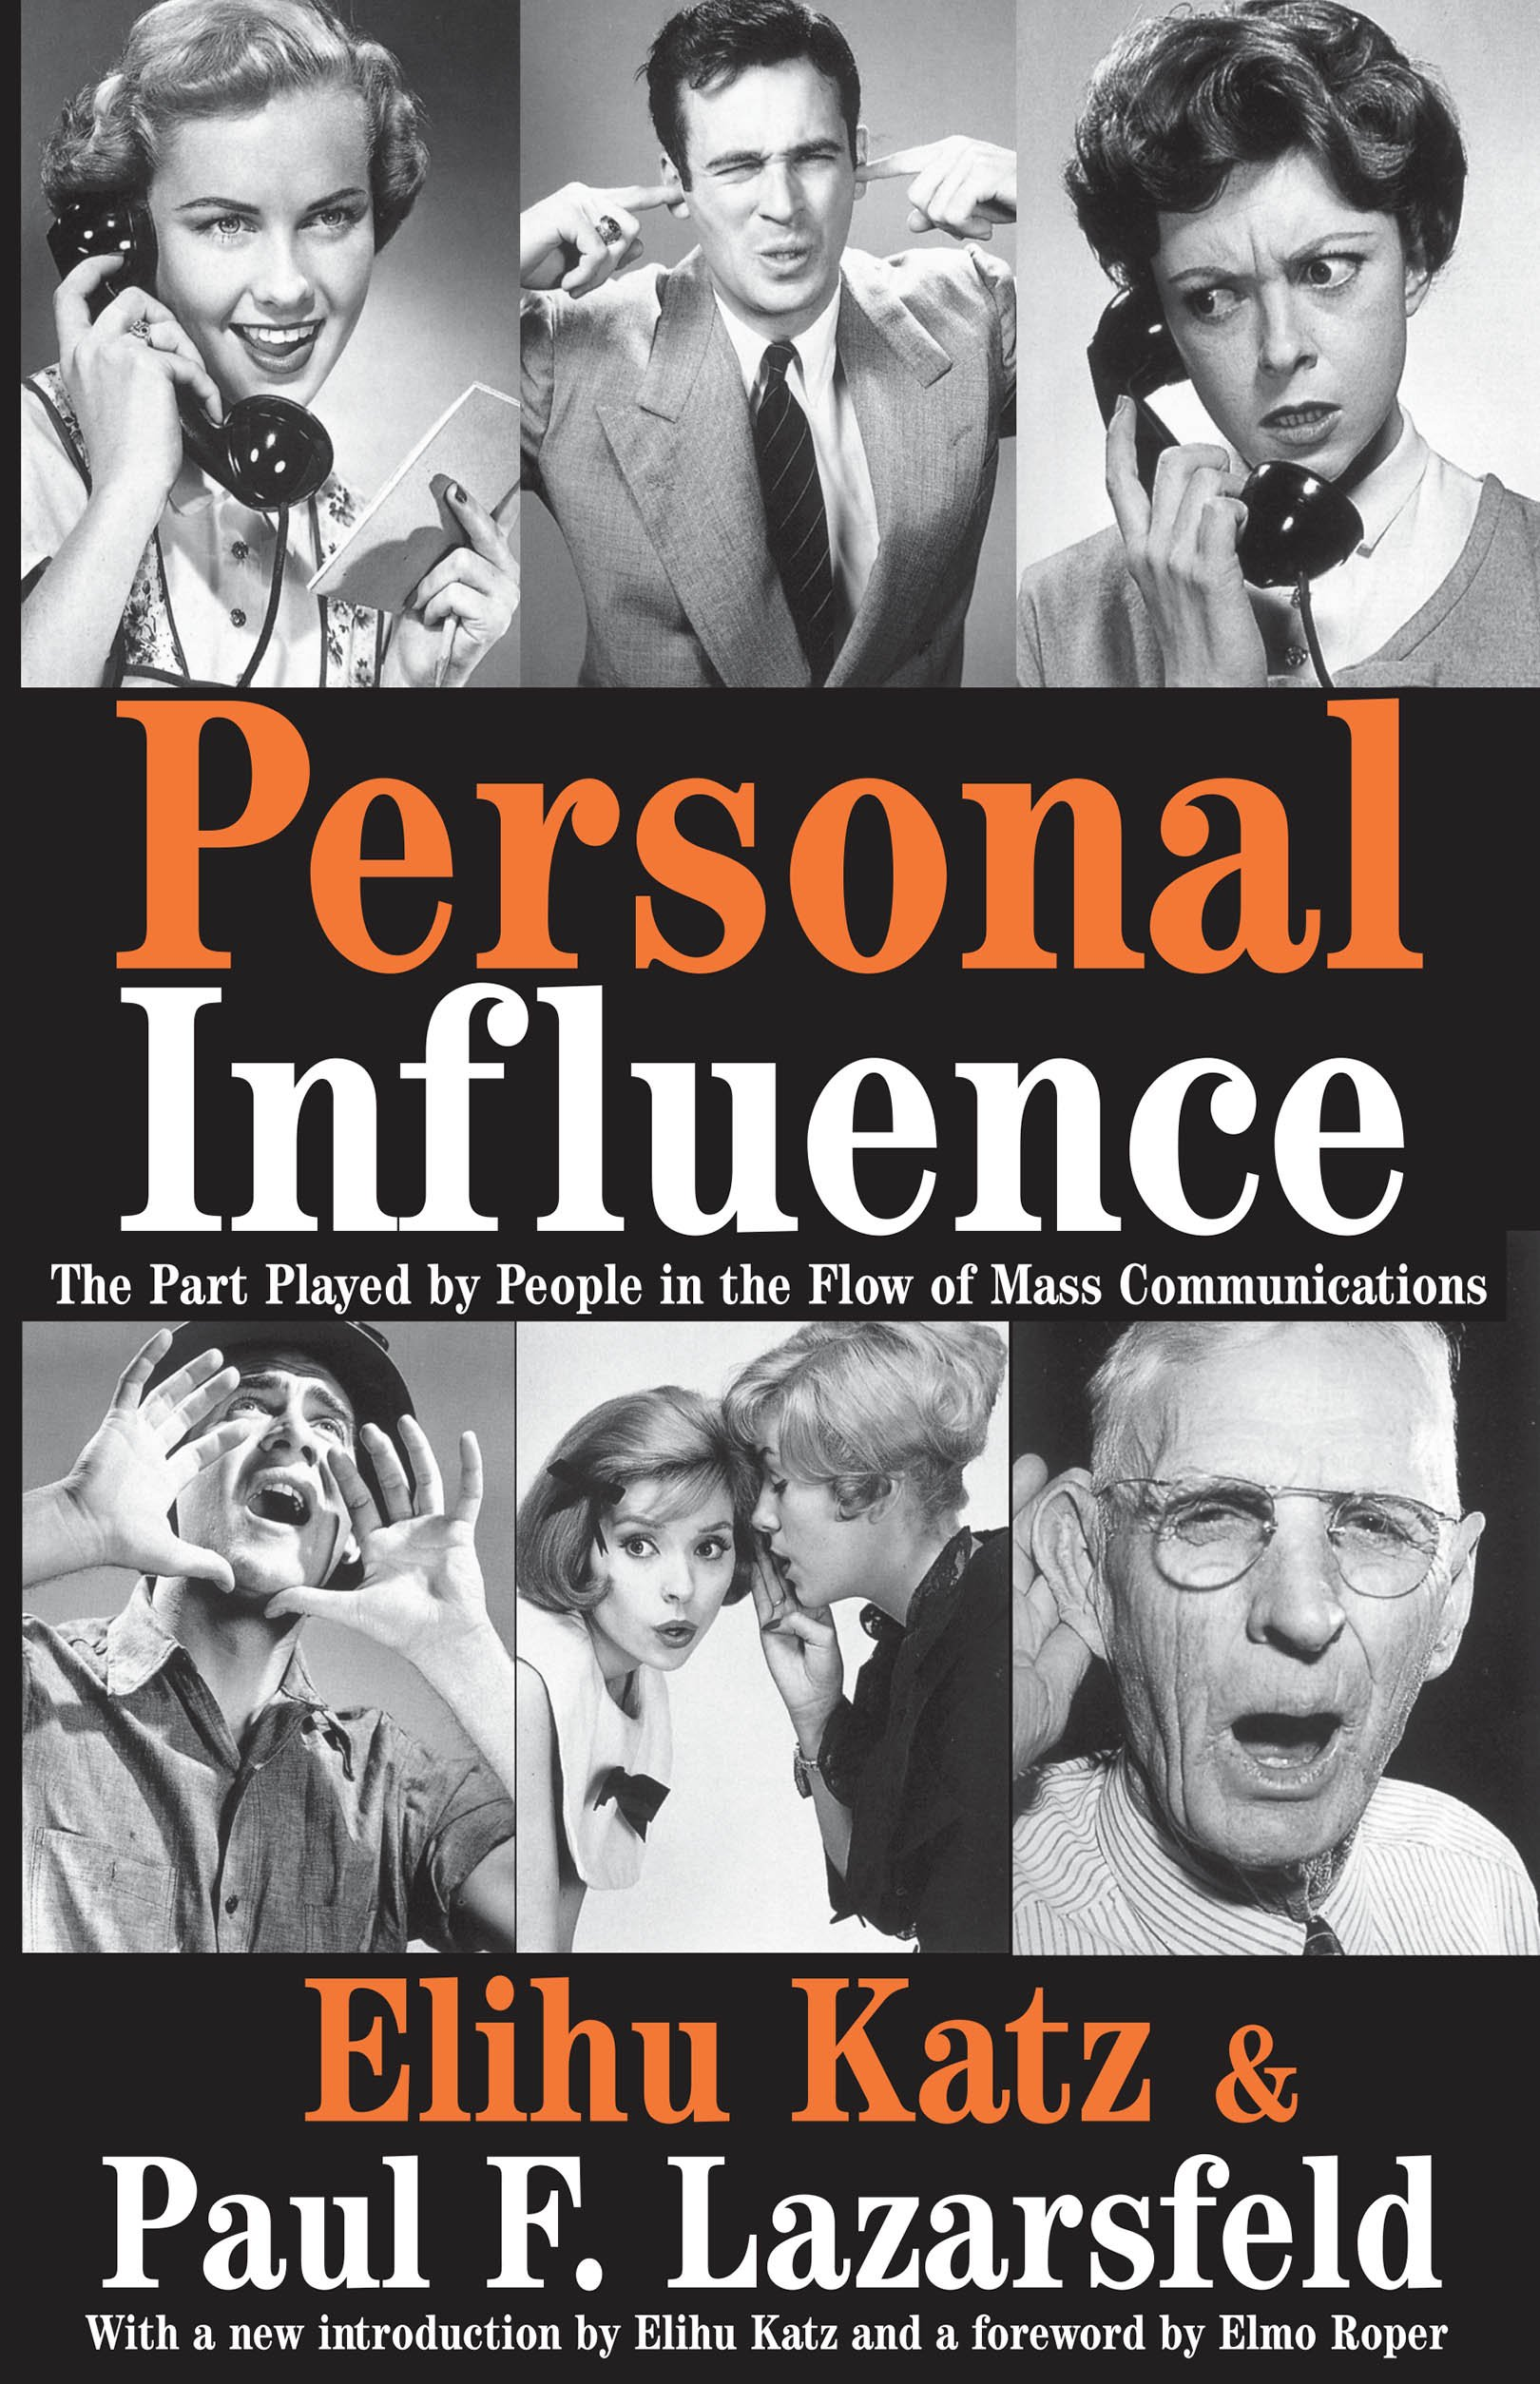
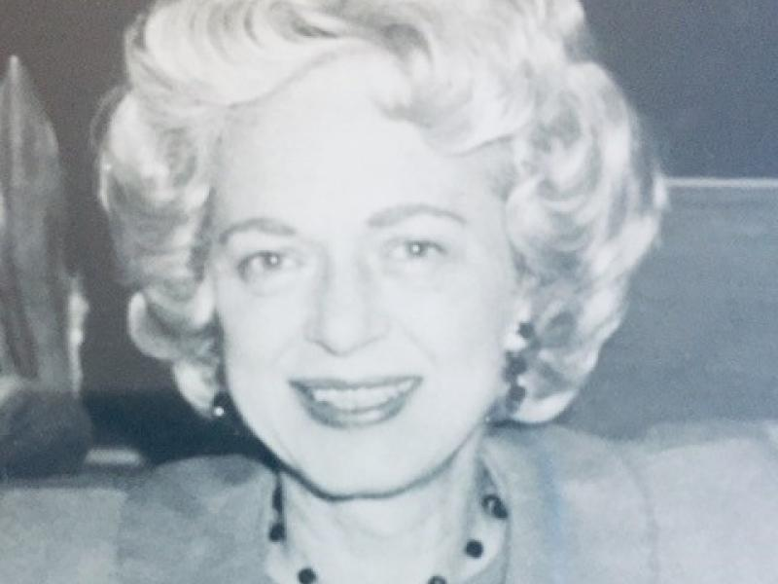
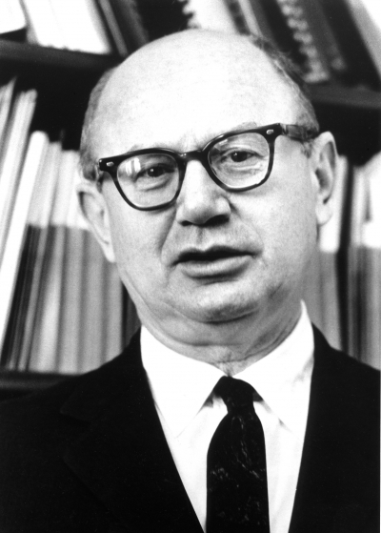
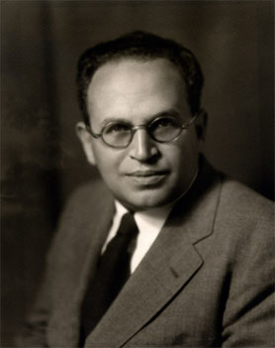
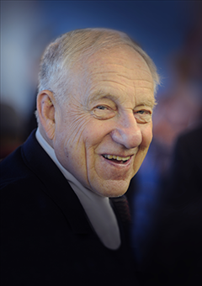
Two steps flow model of communication
Hazel Gaudet-Erskine
Bernard Berelson
Paul Lazarsfeld
Elihu Katz

Slide 4
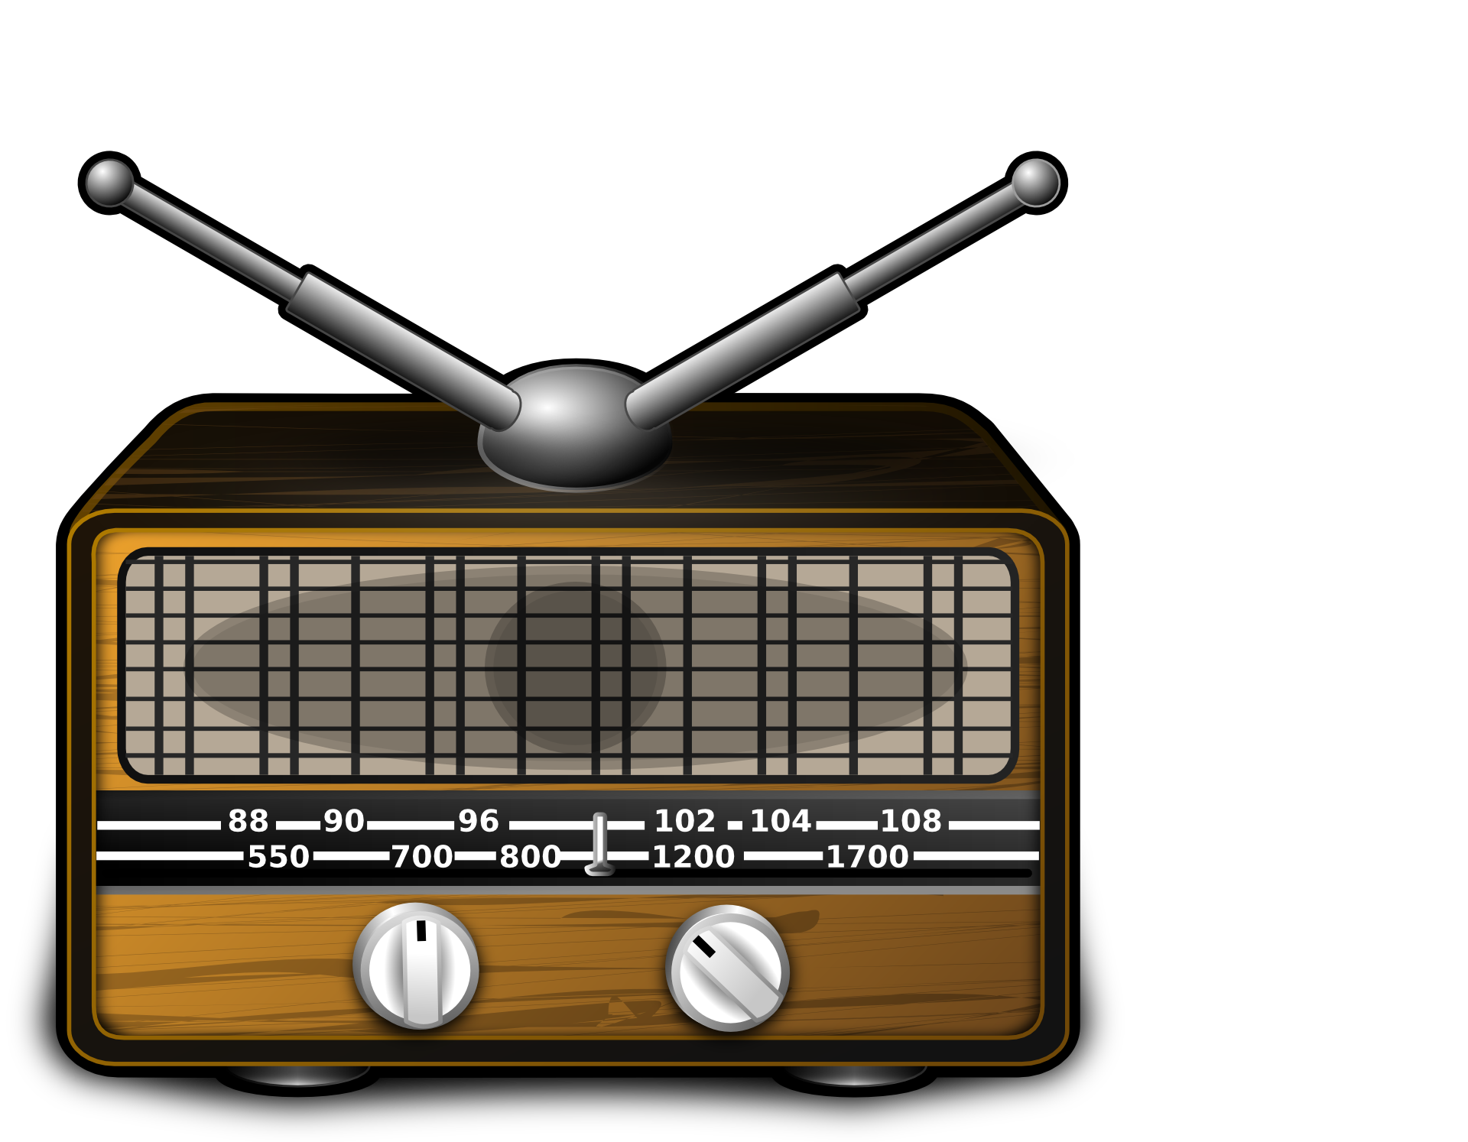
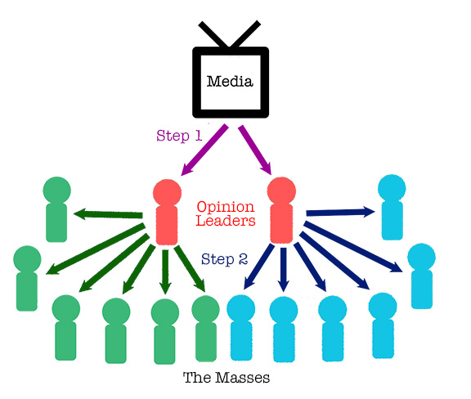

Two steps flow model of communication

Slide 5
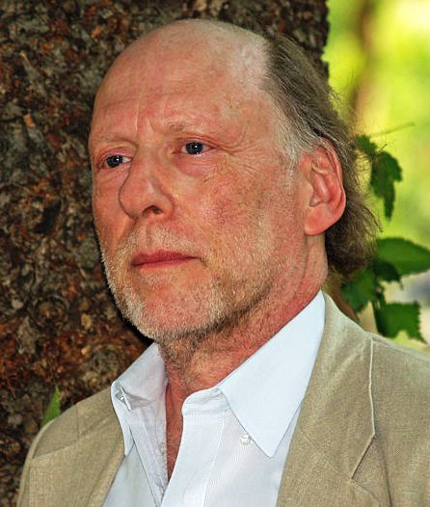
Two-step flow model
Theorization: Information flows from media text to ‘opinion leaders,’ who then relay the information back to the public
“Ideas often flow from radio and print to the opinion leaders and from them to the less active sections of the population” (Berelson et al., 1944)
The Decatur(Illinois) study (Katz & Lazarsfield, 1945)
Decision in marketing, fashions, movie and public affairs
Panel study conducted by interview
Critics by Todd Gitlin (1978):
Selection bias
The flaws in the interpretation
The limited definition of “influence”
The medium?
The Elmira study on voting (Berelson, Lazarsfeld & McPhee, 1948)
Truman v. Deway

Slide 6
Who are the opinion leaders? (Katz, 1957）
Broad definition: individuals who influence the attitudes, beliefs and actions of others (the “influential”).
Who one is – the individual characteristics and values of a person
The opinion follower wants to be like the opinion leader
What one knows – the level of competence or expertise of a person
An opinion follower prefers an opinion with the knowledge, familiarity or expertise on the matter
Whom one knows – the person’s accessibility and the connections they can mobilize
Whom the opinion leader knows within a group and outside
Within the group: the sphere of influence of the opinion leaders is within his/her group
Outside the group: an individual’s influence is not limited to his/her group, but also those who he/she knows outside his/her group

Slide 7
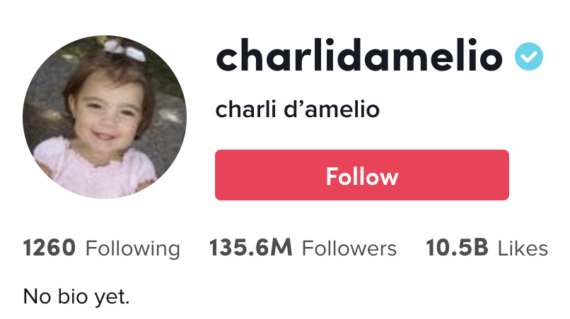



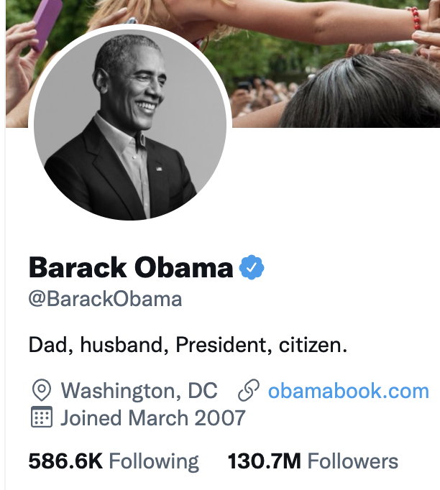
What are the opinion leaders nowadays?

Slide 8
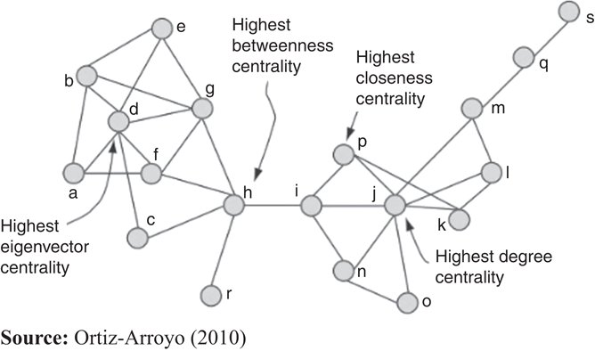
How to measure influence? (Dubois & Gaffney, 2014)
Having a following
Seen as an expert
Knowledgeable/have expertise
The position in the network (some basic network metrics)
(Local) Clustering coefficient:
Measures of centrality:
Degree centrality
Betweeness centrality
Eigenvector centrality

Slide 9
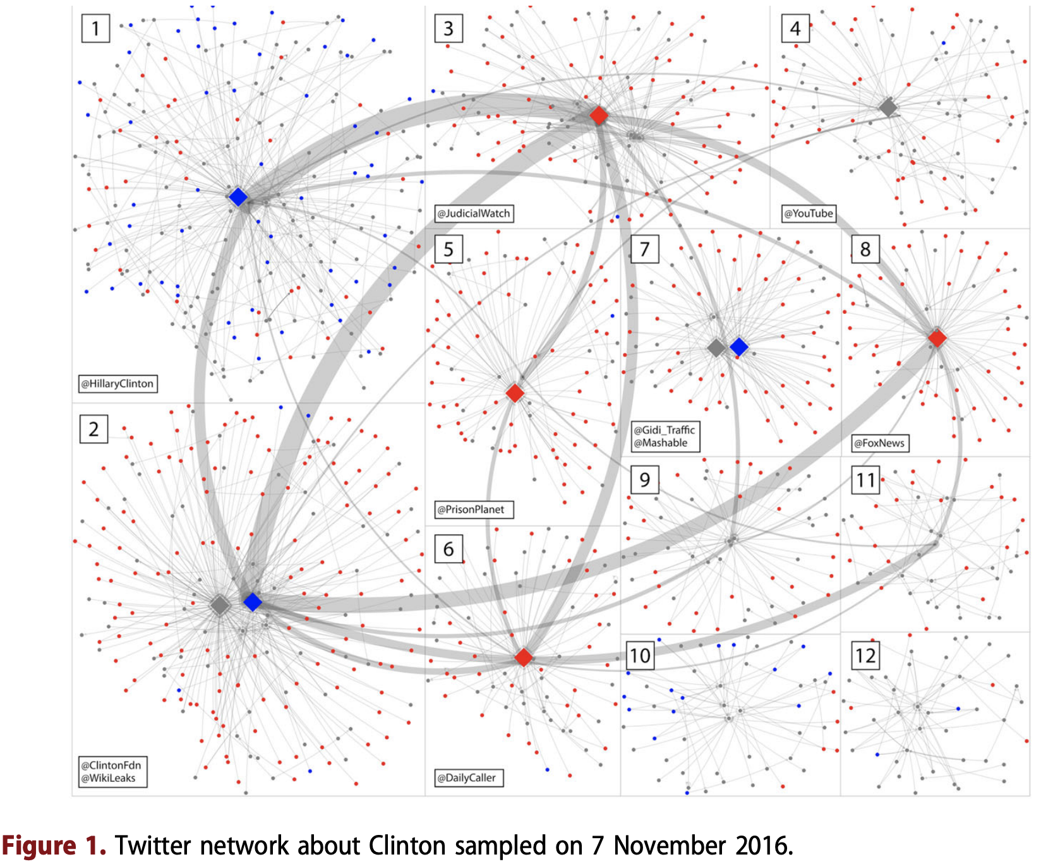
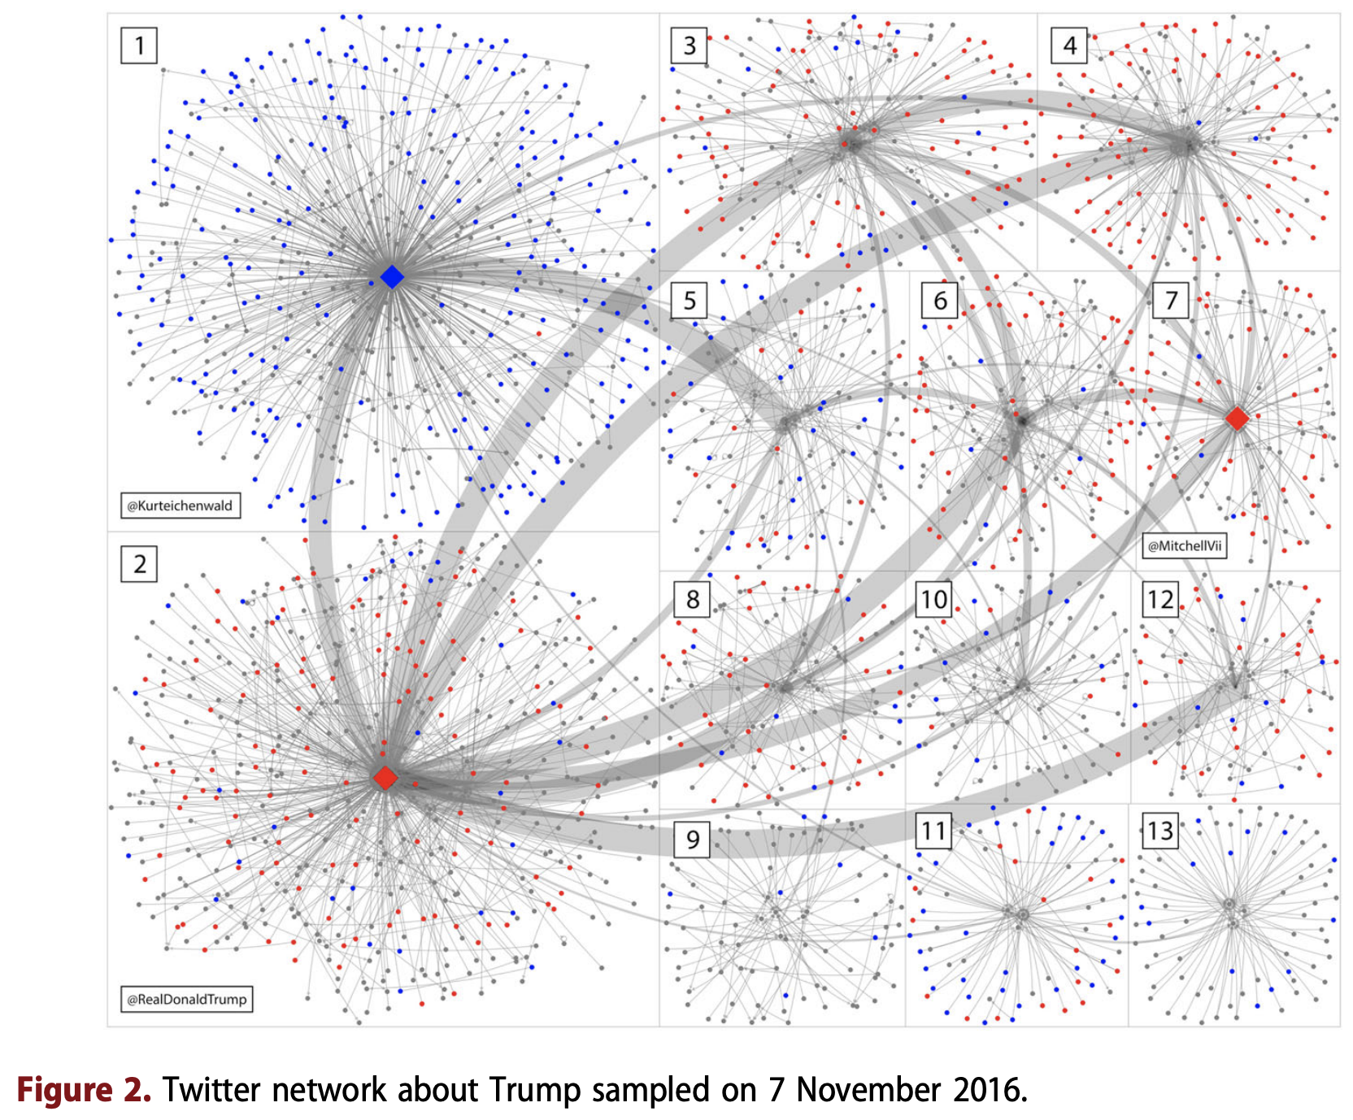
Two step flow in today’s environment (Guo et al., 2018)
Clinton’s network: blue – positive; red – negative; Trump’s network: red – positive; blue – negative

Slide 10
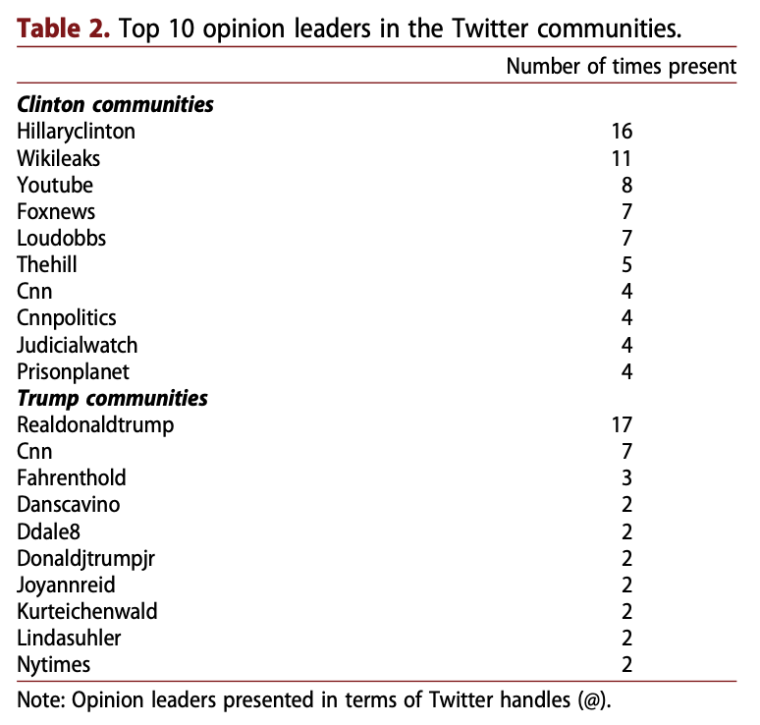
Two step flow in today’s environment (Guo et al., 2018)

Slide 11
A call for modification?
Two step flow model might not be universally correct?!
Direct influence from mass media on audience (Troldahl, 1966)
No significant different between between the mass media exposure of those designated as an influential and those not designated as such (Weimann, 1991; Roch, 2005).
Sole peer influence on decision-making in elections but not media (Robinson, 1976)

Slide 12
Multi-step flow model of communication
Step 3
Mass Media
Step 1a
Opinion leaders
Opinion receivers
/seeker
Step 2
Step 1b
Information receivers

Slide 13
Multi-step flow model – network step flow model
The inclusion of other optional directions (Weimann, 1982):
Horizontal (between leaders, between followers) and vertical (leaders to followers, active to inactive)
Direct (linking two actors directly) and indirect (linking actors through a third party or a chain of intermediaries)
Downward (leaders to followers, media to public) and upward (leaders to media, followers to influentials, marginals to centrals
The introduction of continuous measures of opinion leadership and their validation
Opinion leaders could be both disseminators and recipients of influence
Parasocial opinion leadership
If a media user ascribes certain attributes to a media communicator based on a parasocial relationship, it allows for a gradual influence of the media personality on the user’s opinions and attitudes (Stehr et al., 2015).
Network analysis

Slide 14
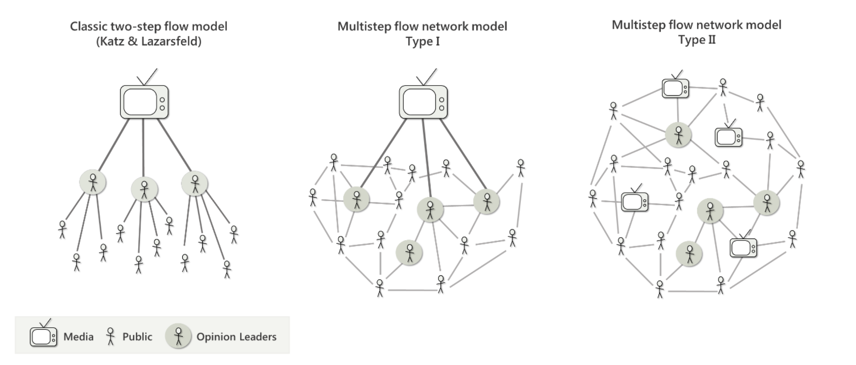
Multi-step flow model – network-step flow model
Source: Ognyanova (2017)

Slide 15
The reemergence to the one-step flow?
A different group of information recipient(Bennet & Manheim, 2006)
Narrowcasting of targeted audiences (e.g., direct mail, targeted telemarketing, receiver-sensitive Web sites, specialized e-mail list)
Fragmentation of communication channel
Social isolation
Is the role of opinion leaders diminishing? Probably not yet.
The role of opinion leaders has not diminished in the new social media environment; this environment has only modified the pattern and form of their operation.

